Slide 1
Classification Of An Offence
25%
10%
How to know if a judgement is a personal wickedness to an offender
25%
30%
10%

Slide 2
CLASSIFICATION OF OFFENCES
Number 1
Number 3
The motive may not be criminal, but once the intention is criminal then the offender becomes liable.
The law is blind to emotions.
Number 4
Number 2
The intention of an accused = Motive (Reason behind the action). The actual intention of the accused = outcome purpose (What the action seeks to achieve or CAN achieve). Intention is proved after the actus has taken place.
Motive is the reason behind an action. Intention is the goal set out to be achieved.

Slide 3
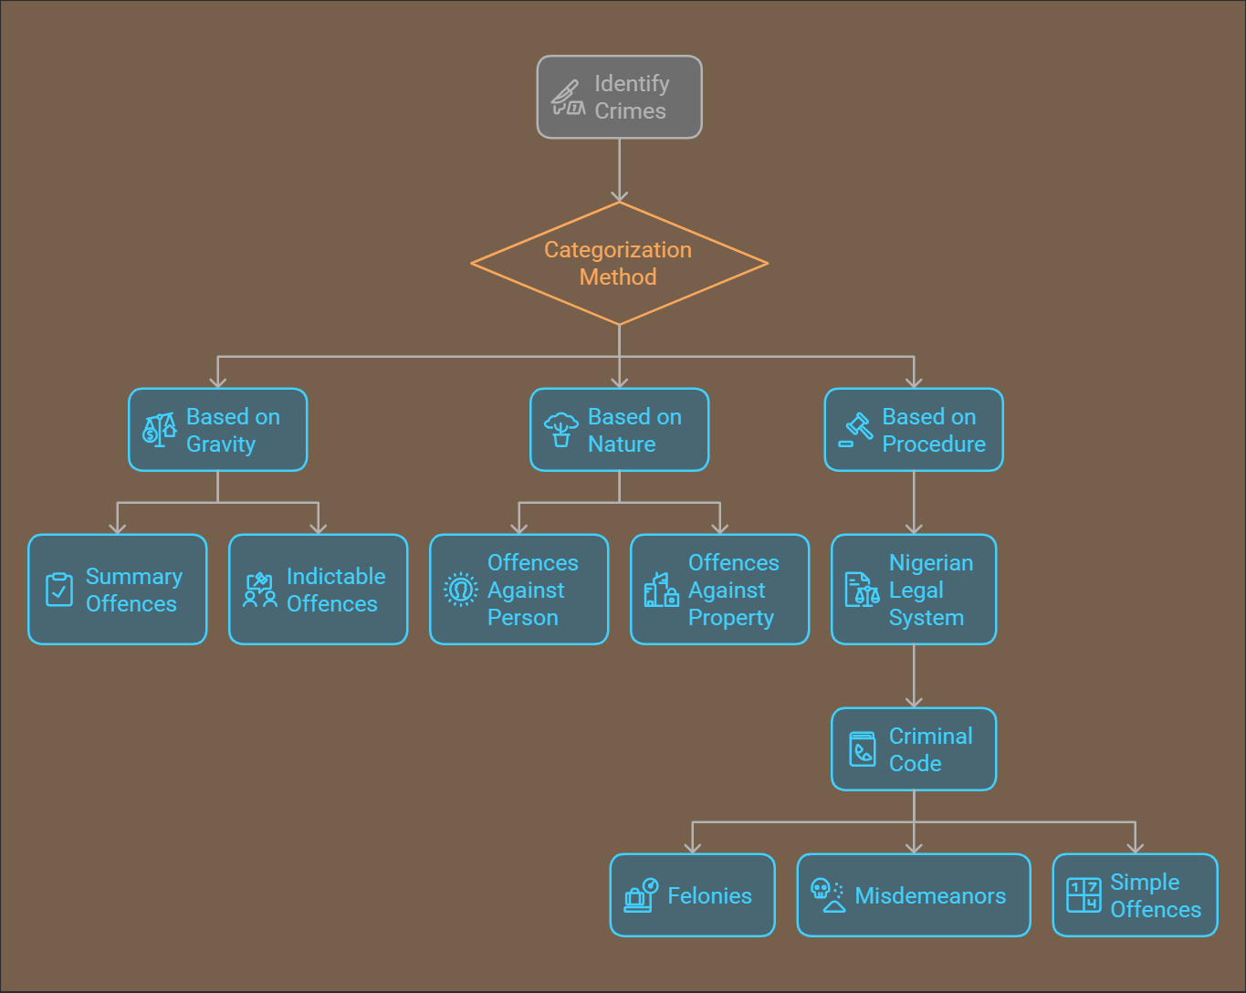

Slide 4
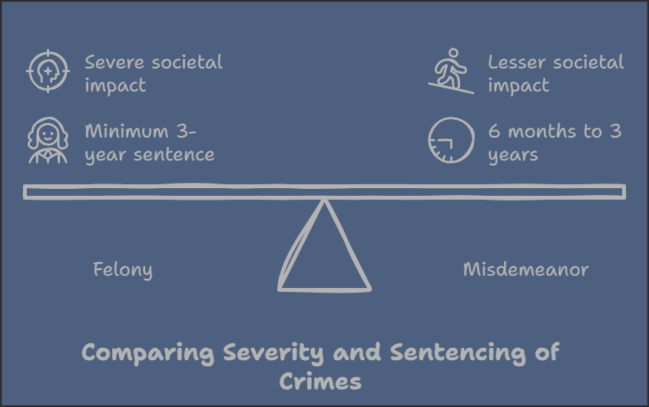

Slide 5
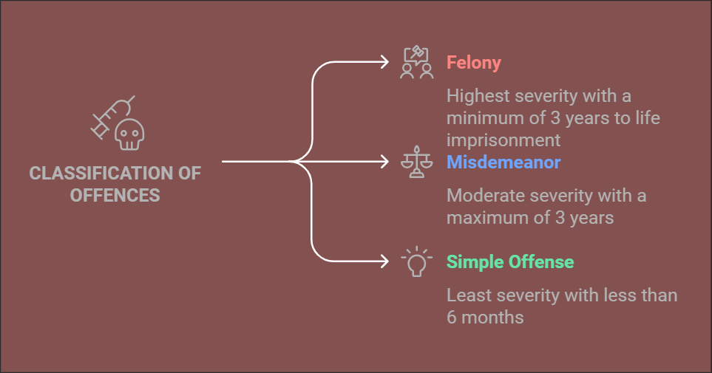

Slide 6
The possible legal implication for the various classification:
The possible legal implication for the various classification:
1
If a person commits a misdemeanor or simple offence, he can get a liberal bail condition than when he commits a felony. Bail can be with liberal condition. Bail can be with strict condition.
2
Some of offences are not triable in magistrate based on their grievous nature. E.g. Armed robbery, murder.
Arrest for misdemeanor and simple offences, private citizens may not be able to arrest without warranty of arrest, but in a case of felony private citizens can arrest without warrant of arrest.
3

